Slide 1
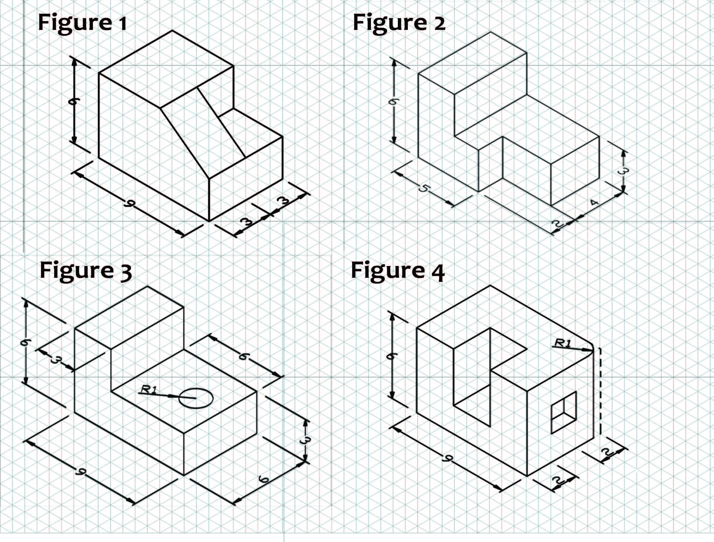
Mitigation Levers That Worked
Design Respins/Qualification
Dual/Multi-Sourcing
Inventory Strategy
Commercial Agreements
Demand Shaping
Pin-compatible alternates
Firmware abstraction layers
Relax non-critical specs
Second-source contracts
Multi-foundry strategies for standard nodes
Strategic safety stocks
Die banking at OSAT
VMI/consignment with distributors
LTAs with CTB clauses
Capacity reservations; prepaid wafers
SKU rationalization
Feature de-optioning
Build-ahead critical subassemblies
NRE cost; validation time; regulatory requalification
Die/package differences; performance spread
Carrying cost; obsolescence risk
Prepay exposure; take-or-pay terms
Revenue mix impact; change management

